Slide 1
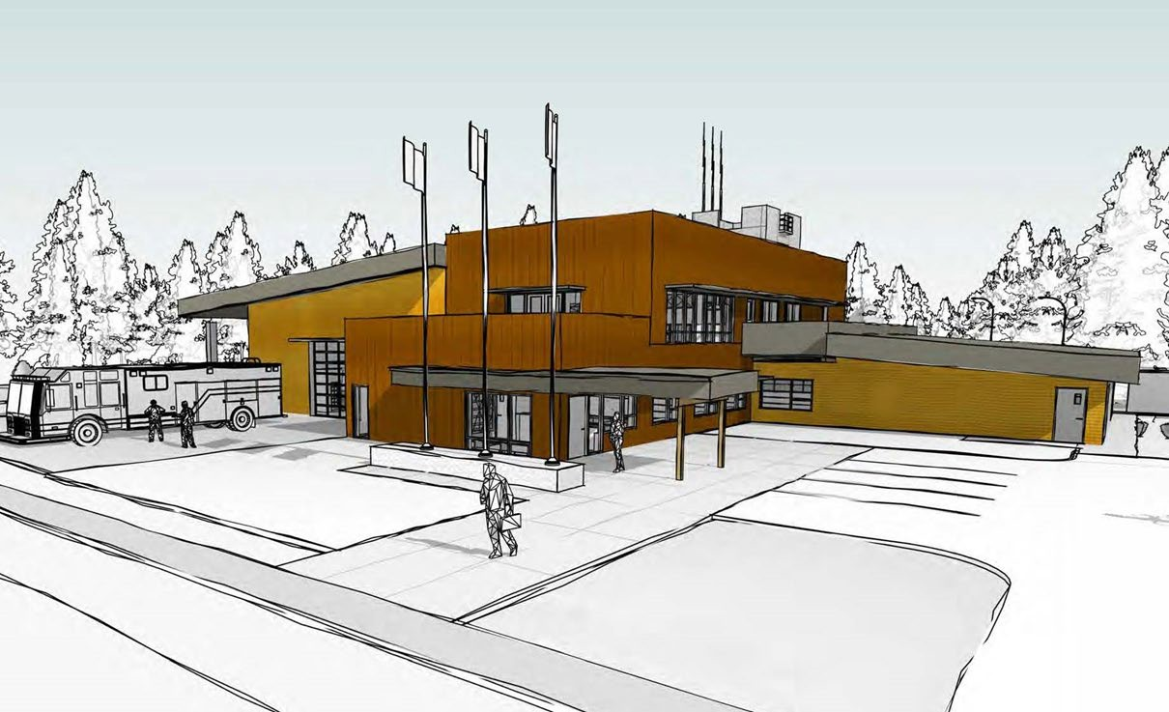

Salt Spring Island Fire Protection District 2024-2029 Strategic Plan Update

Slide 2


A responsive and sustainable fire-rescue service, effectively meeting community needs and valued by those we serve.
Always learning, engaging and adapting to be response ready.
Vision
Mission
STRATEGIC FOCUS
Finances
Our People and Workplace
Infrastructure
Emergency Prevention and Response
Community Relationships
Prudent financial management incorporating long term strategic thinking based on principles of transparency and accountability to all stakeholders to maintain public trust and show value for money.
Attract and retain a diverse, physically and mentally fit team that includes Career, Paid on Call and administrative members to provide value for our community
Infrastructure that supports an effective, reliable and resilient fire service to better address increasing risks and hazards
Deliver a fire-rescue service that prevents and responds to emergencies in a safe, effective and timely manner
Identify and implement effective options to improve response rates
Foster positive relationships to address community concerns and explore opportunities for collaboration
Build collaborative partnerships with other agencies serving Salt Spring Island
GOALS
Develop a proactive mental health support program.
Improve stakeholder engagement in the budget development process.
Communicate to ratepayers a clear rationale for tax increases.
Review hiring and human resource policies and programs to focus on equity and diversity.
Review and update compensation, recognition, training and support programs.
Expand emergency water supply options.
Develop and implement a change management strategy to ensure consistent operations
To increase community connection/collaboration with individual community members for Committee and Trustee position recruitments
OBJECTIVES
Build a new Firehall #1 on time and on budget.
Encourage community engagement, support and participation in fire prevention and life- safety activities
To examine the optimal governance structure for the Salt Spring Fire Protection District
Seek alternative revenue sources to oﬀset increasing costs.
Review and update compensation, recognition, training, and support programs.
Augment the long- term Capital Plan.

Slide 3

Why have a Strategic Plan?
Improved Working
Conditions
Reliable Equipment and Operating Facilities
Where we are now
Where we want to be
Better Community Relations
Fiscal Responsibility

Slide 4
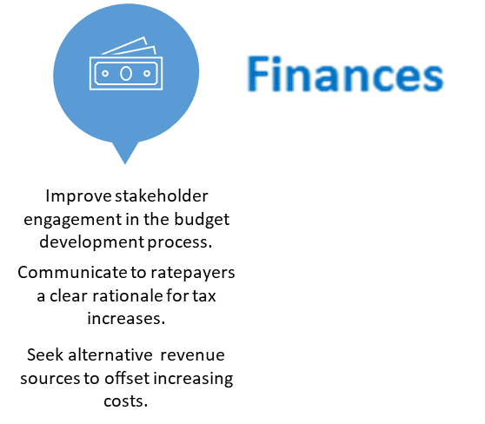


2024 Workplan Activities
Previously Reported:
Develop a comprehensive communication plan to engage stakeholders throughout the budget development process.
Organize town hall meetings, focus groups, or online surveys to gather input and feedback from stakeholders regarding their budget priorities.
Create clear and concise informational materials, such as brochures or infographics, explaining the budgetary challenges and the potential impacts of tax increases.
Conduct a thorough analysis of the budget requirements and the reasons behind any tax increases.
-This year Paid on Call wages were reviewed against other jurisdictions. A wage increase was recommended as a result.
Establish a dedicated location on the webpage to share budget related information.
-Budget information is updated each month and found in the Trustee Board Meeting Package.
-Finance Committee Meetings are now on the Trustee Web Calendar with Agendas.
Explore new revenue streams such as grants or sponsorships.
-7 different grants were applied for in the past 6 months. Provincial, Federal and Municipal Programs.
50%
25%
75%
January 1, 2024
Progress to January 2025

Slide 5







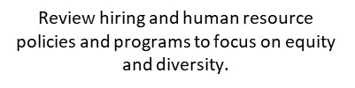
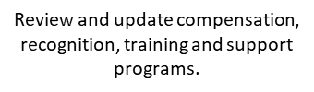

2024 Workplan Activities
Previously Reported:
Collaborate with mental health experts and professionals to design a comprehensive
mental health support program tailored to the speciﬁc needs of the workforce.
Oﬀer regular mental health workshops, seminars, or webinars that address stress management, resilience, and coping strategies.
Train managers and supervisors to recognize signs of mental health issues and create a supportive environment for employees to seek help.
Conduct a comprehensive analysis of the current compensation on structure to ensure it is competitive and aligns with industry standards and local cost of living.
Hire and train a diverse staff.
-the 2025 Paid on Call hire includes visible minorities (28%), females (28%) and males (44%).
A new private web page has been developed for the Paid-on-Call staff. It is a recourse for accessing benefits and claim forms, submitting expense claims, submitting CRA TD1 forms, and accessing employment forms.
Health Benefits.
Health Benefits were increased in 2024 from $1,000 to $1,500 per year for Paid-on-Call Staff.
The Mental Health Budget was increased by $10,000 in 2024 with unspent funds going to a health reserve fund
50%
25%
75%
January 1, 2024

Slide 6




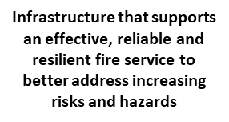




2024 Workplan Activities
Previously Reported:
Develop a detailed project plan that includes timelines, milestones, and a budget estimate for the construction of the new Firehall.
Engage with architectural ﬁrms and construction contractors through a competitive bidding process to select the most suitable partners for the project.
Regularly monitor and track progress during the construction phase to ensure the project remains on schedule and within the allocated budget.
Conduct thorough quality control inspections and safety checks through out the construction process.
Continue to monitor and assess and respond to risks associated with the New Fire Hall construction project.
Engage leadership to gather insights into new infrastructure and improvements to existing infrastructure
  New water reserve pond is being planned for 2025 at the Fulford Hall. (low cost, big impact)
  Land Acquisition opportunities are being sought and pursued. (donations and swaps)
  Engage in opportunities capital purchases for used equipment. (2 used vehicles purchased in 2024)
  The Fire Rescue service obtained a portable fire tank and pump. This is a quick response unit for brush fires. The unit fits on a half ton truck and can go most places a road is laid.
50%
25%
75%
January 1, 2024

Slide 7
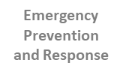



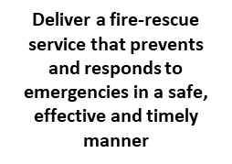
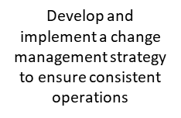

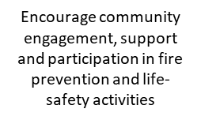
2024 Workplan Activities
Previously Reported:
Develop tailored educational materials and workshops to address the identified concerns and promote ﬁre safety practices. (FireSmart)
Collaborate with local schools, community centers, and businesses to incorporate ﬁre safety education into their programs and events.
Organize regular community outreach events, such as open houses or safety fairs, to raise awareness about ﬁre prevention and safety measures.
Utilize social media and other digital platforms to share ﬁre safety 0ps, success stories, and community initiatives to engage a wider audience.
-Install a new Dispatch system with incident reporting and shift tracking. This involves lots of training, testing and innovation. This work is ongoing until March when the new system is stable for use.
-Engaged FUS to perform a Tender pumping test on in early 2025. This is a significant test of our equipment, staff and training and the results may impact all persons with fire insurance in the Island.
-Participating in a broader reciprocity agreement with other municipalities for emergency services.
50%
25%
75%
January 1, 2024

Slide 8



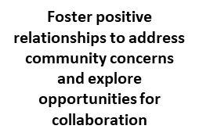
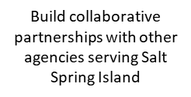
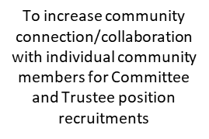

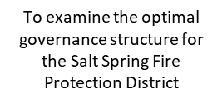
2024 Workplan Activities
Previously Reported:
Identify key agencies and organizations that play a signiﬁcant role in serving the community on Salt Spring Island.
Reach out to representatives from these agencies to initiate dialogue and discuss potential areas of collaboration.
Organize joint meetings or workshops to understand each agency's goals, challenges, and opportunities for synergy.
Identify common community concerns and explore how multiple agencies can pool their resources and expertise to address them eﬀectively.
Establish a formal collaboration agreement or memorandum of understanding (MOU)that outlines the objectives.
Participated in two “Ask Salt Spring” town hall discussions. One on Fire Smart, one on the District activates. Both well received.
Increased the advertising budget for elections and election advertising to increase Trustee nominations
Continued building collaborative partnerships with North Salt Spring Water
Invited Rob Botterell, MLA for Saanich North and the Islands to visit the Fire District for lunch.
Established a new Trustee election policy which allows for mail in ballots as an option.
50%
25%
75%
January 1, 2024

